Slide 1

Whales
Non-chronological Reports
Facts about animals

Slide 2
About Whales
There are two types of whales:
Toothed whales and baleen whales.
A whale is a mammal (not a fish)
Whales are the largest mammals in the world.
Breathe through a blow-hole
Often travel in groups known as a pod.

Slide 3
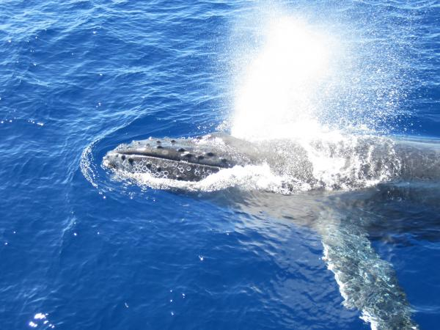
Do whales Breathe?
Yes, they surface to catch a deep breath.
They can hold their breath underwater between 20 minutes and 2 hours.
They breathe through their blowhole

Slide 4
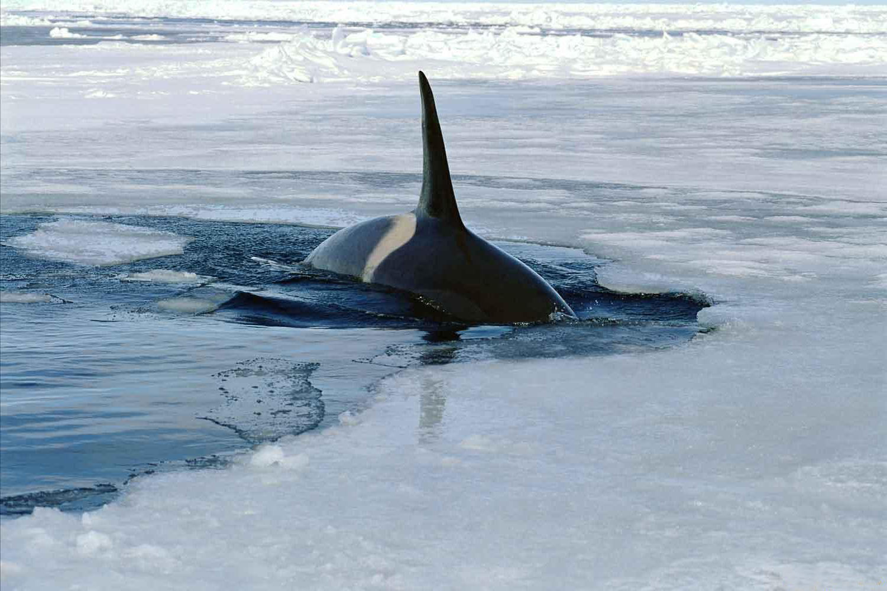
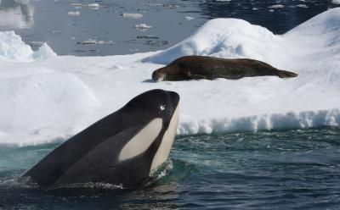
Where do they live?
Whales live in the water. They can’t survive on land.
They have a layer of blubber that keeps them warm in the freezing ocean.
Whales would overheat and could not survive on land.

Slide 5
Baleen Whales
Blue whale
Humpback whales
Toothed whales
Killer whale
Beluga Whale

Slide 6
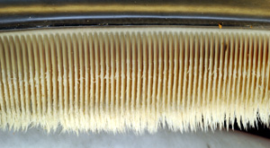
What are baleens?

